Slide 1
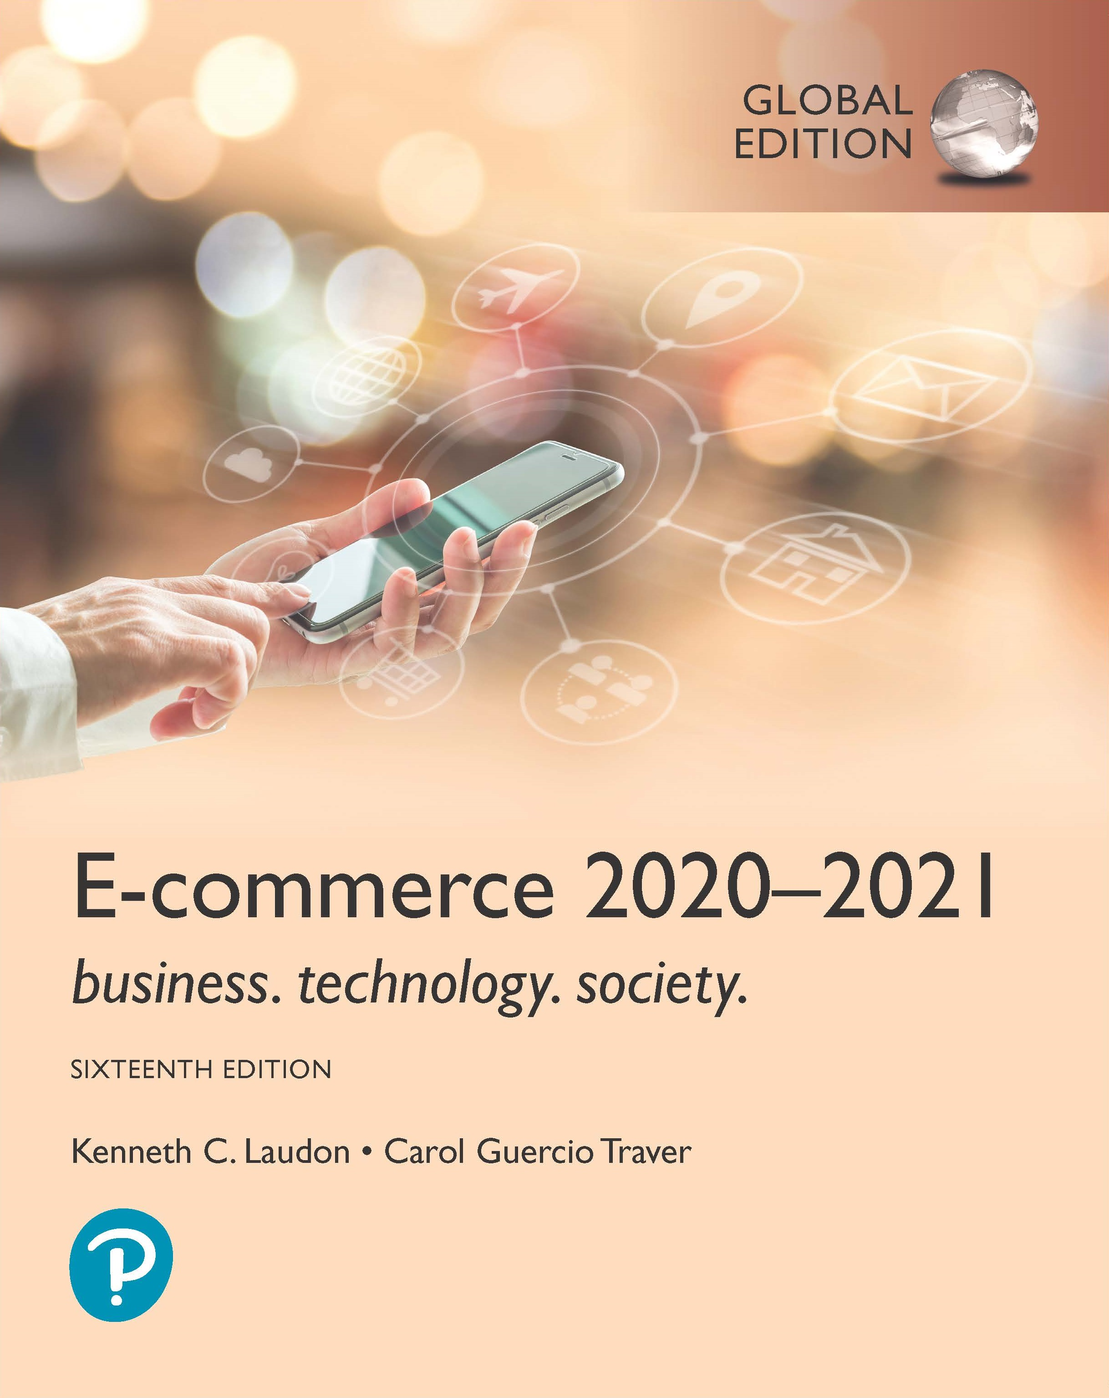
E-commerce 2020-2021: Business. Technology. Society.
Sixteenth Edition, Global Edition
Chapter 4
E-commerce Security and Payment Systems
Copyright © 2021 Pearson Education Ltd. All Rights Reserved
Notes:
If this PowerPoint presentation contains mathematical equations, you may need to check that your computer has the following installed:
1) MathType Plugin
2) Math Player (free versions available)
3) NVDA Reader (free versions available)

Slide 2
Learning Objectives
4.1 Understand the scope of e-commerce crime and security problems, the key dimensions of e-commerce security, and the tension between security and other values.
4.2 Identify the key security threats in the e-commerce environment.
4.3 Describe how technology helps secure Internet communications channels and protect networks, servers, and clients.
4.4 Appreciate the importance of policies, procedures, and laws in creating security.
4.5 Identify the major e-commerce payment systems in use today.
4.6 Describe the features and functionality of electronic billing presentment and payment systems.

Slide 3
Technology Solutions
Protecting
Protecting Internet communications
Encryption
Securing
Securing channels of communication
S S L, T L S, V P N s, Wi-Fi
Protecting
Protecting networks
Firewalls, proxy servers, I D S, I P S
Protecting
Protecting servers and clients
O S security, anti-virus software
Notes:
Intrusion Prevention System.
Intrusion Detection System.
Transport Layer Security

Slide 4
Figure 4.5 Tools Available to Achieve E-commerce Security
Notes:
Figure 4.5, Page 288.
There are a number of tools available to achieve e-commerce security.
Full description: A diagram depicts the different tools available to achieve e-commerce security. The diagram shows Security Management in the center and the following points surrounding it. Firewalls, Encryption, Network Security Protocols, Virtual Private Networks, Authentication Procedures, Proxy Servers, Anti-Virus Software, Automated Software Updates, Intrusion Detection and Prevention.

Slide 5
Encryption
Encryption
Transforms data into cipher text readable only by sender and receiver
Secures stored information and information transmission
Provides 4 of 6 key dimensions of e-commerce security:
Message integrity – provides assurance that the message has not been altered
Nonrepudiation – prevents the use from denying he or she sent the message
Authentication – provides verification of the identity of the person sending the message.
Confidentiality – gives assurance that the message was not read by others
Notes:
Two of the 6 key dimensions of the e-commerce security
Privacy
Availability

Slide 6
Symmetric Key Cryptography
Sender and receiver use same digital key to encrypt and decrypt message
Requires different set of keys for each transaction
Strength of encryption: Length of binary key
Data Encryption Standard (DES) - The data encryption standard developed by the National Security Agency (NSA) and IBM 1950s DES uses a 56-bit encryption key.
Advanced Encryption Standard (AES) - Today the most widely used symmetric key algorithm is advanced encryption standard which offers key sizes of 128, 192 and 256 bits
Other standards use keys with up to 2,048 bits

Slide 7
Public (Asymmetric) Key Cryptography
Uses two mathematically related digital keys
Public key (widely disseminated)
Private key (kept secret by owner)
Both keys used to encrypt and decrypt message
Once key used to encrypt message, same key cannot be used to decrypt message
Sender uses recipient’s public key to encrypt message; recipient uses private key to decrypt it

Slide 8
Figure 4.6 Public Key Cryptography: A Simple Case
Notes:
Figure 4.6, Page 291.
In the simplest use of public key cryptography, the sender encrypts a message using the recipient’s public key, and then sends it over the Internet. The only person who can decrypt this message is the recipient, using his or her private key. However, this simple case does not ensure integrity or an authentic message.
Full description: An image illustrates a simple use of public key cryptography and the important steps in using public and private keys. The steps are as follows. First, the sender creates an original digital message, to buy X Y Z at the rate of 100 dollars. Second, the sender obtains the recipient’s public key and applies it to the message. Third, this message gets encrypted in cipher text, depicted as 1 0 1 0 1 1 0 1 1 1 0 0 0 1. Fourth, the message is sent over the Internet. And fifth, the message is received by the recipient, who uses his or her private key to decrypt the message..

Slide 9
Securing Channels of Communication
Secure Sockets Layer (S S L)/Transport Layer Security (T L S)
Establishes secure, negotiated client-server session
Virtual Private Network (V P N)
Allows remote users to securely access internal network via the Internet
Wireless (Wi-Fi) networks
WPA2
WPA3
Wi-Fi Protected Access
Is the most common form of securing channels

Slide 10
Protecting Networks
Firewall
Hardware or software that uses security policy to filter packets
Packet filters – examine data packets to determine whether they are destined for a prohibited port or originate from a prohibited IP address
Application gateways – that filters communications based on the application being requested.
Next-generation firewalls – uses an application-centric approach
Proxy servers (proxies)
Software servers that handle all communications from or sent to the Internet acting as a bodyguard for the organisation.
Intrusion detection systems
Intrusion prevention systems
Notes:
IDS – examines network traffic, watching to see if it matches certain patterns or preconfigured rules indicative of an attack.
IPS – has all functionality of an IDS, with the additional ability to take steps to prevent and block suspicious activities

Slide 11
Figure 4.11 Firewalls and Proxy Servers
Notes:
Figure 4.11, Page 301.
The primary function of a firewall is to deny access by remote client computers to local computers. The primary purpose of a proxy server is to provide controlled access from local computers to remote computers.
Full description: A set of flow diagrams illustrates how firewalls and proxy servers provide protection for networks. A linear flow diagram for a firewall shows, from left to right, a laptop, desktop, and a mobile phone connected to a firewall with two-way arrows. The firewall connects with a remote client on the Internet through a web server. A remote server is present on the side of the remote client. A linear flow diagram for proxy server shows, from left to right, a laptop, desktop, and a mobile phone connected two-way with an internal network. The internal network is connected two-way with a proxy server. The proxy server connects to a remote client on the Internet through an external network. A remote server is present on the side of the remote client.

Slide 12
Protecting Servers and Clients
Operating system security enhancements
Upgrades, patches
Anti-virus software
Easiest and least expensive way to prevent threats to system integrity
Requires daily updates

Slide 13
Management Policies, Business Procedures, and Public Laws
Worldwide, companies spend more than $86 billion on security hardware, software, services
Managing risk includes:
Technology
Public laws and active enforcement
Effective management policies

Slide 14
Developing an E-commerce Security Plan:
Five steps involved in building an e-commerce security plan
Notes:
Perform a risk assessment: An assessment of the risks and points of vulnerability
Develop a security policy: A set of statements prioritizing the information risks, identifying acceptable risk targets, and identifying the mechanisms for achieving these targets.
Develop an implementation plan: The action steps you will take to achieve the security plan goals
Create a security organization educates and trains users, keeps management aware of security threats and breakdowns, and maintains the tools chosen to implement security
Perform a security audit: involves the routine review of access logs (identifying how outsiders are using the site as well as how insiders are accessing the site’s assets)

Slide 15
The Role of Laws and Public Policy
Laws that give authorities tools for identifying, tracing, prosecuting cybercriminals:
U S A Patriot Act, which expanded law enforcement’s investigative and surveillance powers.
Homeland Security Act, preventing and responding to natural and man-made disasters.
Private and private-public cooperation
U S-C E R T (Computer Emergency Readiness Team)
C E R T Coordination Center – Monitors and tracks online criminal activity
Government policies and controls on encryption software
O E C D(Organisation for Economic Cooperation and Development), G7/G8, Council of Europe, Wassener Arrangement
Notes:
Wassener Arrangement – which includes 42 countries that produce sensitive industrial equipment or weapons

Slide 16
E-commerce Payment Systems
In U.S., credit and debit cards are primary online payment methods
Other countries have different systems
Limitations of online credit card payment
Security, merchant risk
Administrative and transaction costs
Social equity – not very democratic, even though they seem ubiquitous. Millions of young adults do not have credit cards and millions of others who cannot afford cards

Slide 17
Alternative Online Payment Systems
Online stored value systems:
Based on value stored in a consumer’s bank, checking, or credit card account
Example: PayPal
Other alternatives:
Amazon Pay
Visa Checkout, Mastercard’s MasterPass
Dwolla – a payment service that transfers money from a customer’s bank account to firms they want to pay without using the major credit card processing systems.

Slide 18
Mobile Payment Systems
Use of mobile phones as payment devices
Established in Europe and Asia
Expanding in United States
Near field communication (N F C)
Different types of mobile wallets
Universal proximity mobile wallets, such as Apple Pay, Google Pay, Samsung Pay, PayPal Mobile
Branded store proximity wallets, offered by Walmart, Target, Starbucks, others
P2P mobile payment apps, such as Zelle, Venmo

Slide 19
Blockchain
Blockchain
Enables organizations to create and verify transactions nearly instantaneously using a distributed P2P database (distributed ledger)
Benefits:
Reduces costs of verifying users, validating transactions, and risks of storing and processing transaction information
Transactions cannot be altered retroactively and therefore are more secure
Foundation technology for cryptocurrencies and supply chain management, as well as potential applications in financial services and healthcare industries

Slide 20
Figure 4.16 How Blockchain Works
Notes:
Figure 4.16, Page 318. A blockchain system is a distributed database that records transactions in a P2P network of computers.
Full description: A process diagram shows six steps illustrating how blockchain works. 1. An order is submitted by a user or customer. 2. To verify the user, the transaction is broadcast to a P2P network of computers. 3. The transaction is validated by others in the network. 4. The block is added to the chain of transactions for this user. 5. Production, Warehouse, Logistics add additional blocks. 6. The order is fulfilled.

Slide 21
Cryptocurrencies
Use blockchain technology and cryptography to create a purely digital medium of exchange
Bitcoin the most prominent example
Value of Bitcoins have widely fluctuated
Major issues with theft and fraud
Some governments have banned Bitcoin, although it is gaining acceptance in the U.S.
Other cryptocurrencies (altcoins) include Ethereum/Ether, Ripple, Litecoin and Monero
Initial coin offerings (I C Os) being used by some startups to raise capital

Slide 22
Electronic Billing Presentment and Payment (E B P P)
Online payment systems for monthly bills
Four E B P P business models:
Online banking model (most widely used)
Biller-direct
Mobile
Consolidator
All models are supported by E B P P infrastructure providers

Slide 23
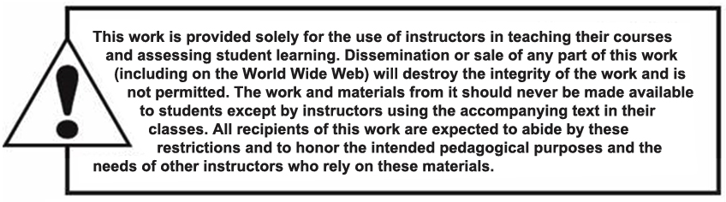
Copyright

